Slide 1
Hybrid Approach to RAG
Team members:
Sagnick Bhar
Sumit Prakash
Aman Khurana

Slide 2
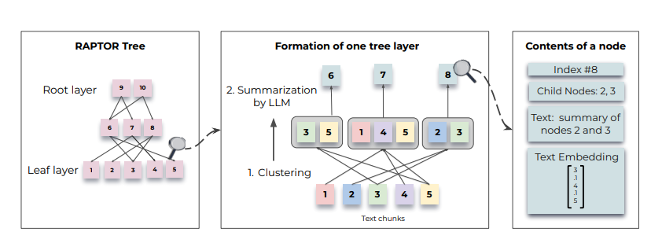
Previously
RAPTOR (Recursive Abstractive Processing for Tree-Organized Retrieval) is a retrieval method as follows:
To group similar text chunks, employed a soft clustering algorithm (GMMs).
Once clustered, a Language Model is used to summarize the grouped texts
These summarized texts are then re-embedded, and the cycle of embedding, clustering, and summarization continues until further clustering becomes infeasible

Slide 3
Problems
A lot of redundant and often unnecessary tokens gets retrieved.
It may disrupt the natural sequential flow of information in a document
Ex: Legal Documents & Contracts: A contract might define terms at the beginning, list obligations in the middle, and outline penalties at the end. If RAPTOR groups sections only by similarity (e.g., all penalty-related clauses together), it may disconnect obligations from penalties, leading to an incomplete legal interpretation.

Slide 4
Hybrid Approach
Within each document where order of context matters implement clustering based on sequential order of text chunks.
Outside document level use the usual raptor where clustering occurs based on similarity between the node embeddings.
Add an extra line in summarization prompt to make sure the summarized text tokens follow sequential ordering.

Slide 5

Idea 1
t_{d1}0
d1t1
t_{d1}1
t_{d1}2
D₁
t_{d1}3
C1
d1t2
t_{d1}4
t_{d1}5
t_{d2}0
C0
C2
D₂
t_{d2}1
t_{d3}3
Sequential Order
d3t2
C3
D_{m}
d3tn
Sequential grouping and summarization of nodes
Clustering nodes semantically

Slide 6
Problem
There can still be the problem of overlooking distant interdependencies within document level.

Slide 7
Idea 2
1. Fetch top k documents.
t_{d1}0
d1t1
t_{d1}1
t_{d1}2
D₁
t_{d1}3
C1
d1t2
t_{d1}4
t_{d1}5
t_{d2}0
C0
C2
D₂
t_{d2}1
t_{d3}3
Sequential Order
2. For each document, select the most relevant node bottom up and recursively aggregate the summary text of each parent node until a common ancestor is reached.
C3
d3t2
D_{m}
d3tn
Clustering nodes semantically
Sequential grouping and summarization of nodes

Slide 8
Meeting Notes
Summarization quality, it should add information, but does not correlate text chunks. (But since I am storing information bottom up, we do not have to rely on context fully from summarized nodes).
Distance of nodes in the tree and considering those doc summaries which have few matching text chunks can give irrelevant info for the overall ans.
Idea: 1. Weighting of each level node(highest-bottom to lowest-top) in the generation prompt(but depends on LLM and token count is still same.)(kind of like inverse reciprocal rank function) and for distance something like path compression may work.
2. If a raw text chunk is very far from other relevant chunks within a document, a lot of unnecessary info will get accumulated from the non-leaf nodes above it. Solution: Add some distance metric to far away node. So that not all non-leaf nodes get retrieved.

Slide 9
THANK YOU

